Slide 1
Elevator Application
By Student Name

Slide 2
Introduction
The application is a simulation of an elevator system operating in a particular building.
The elevator serves several floors in a building moving up and down as it picks and drops users who have boarded it.
User’s can board the elevator if it reaches the floor from which they have requested to board and the elevator is not full
An elevator is evaluated as full depending on the number of people on board and the total weight of the people on board

Slide 3
Overview of System Operations
Passengers arrive in the building
Initialize the elevator
Run the simulation

Slide 4
Passengers Arrive In The Building
This operation is carried out by allowing the user to specify the number of people who work at the company.
Once the number is provided, the user proceeds to provide the name and weight for each of the passengers
Finally, a thread is created from the passenger information and it starts running.

Slide 5
Passengers In the Building
All passengers start at floor 0 and request to go to a random floor in the building
Once they arrive at the intended floor, the thread sleeps for a random number of seconds to simulate working
The next step is to request the elevator to go to another floor to continue working

Slide 6
Elevator Initialization
There is only one elevator in the building
It is also run as a thread
The elevator has a maximum weight and maximum number of people it can carry.
It keeps track of the people on board and runs until the end of the company work day after everyone has left

Slide 7
Running The Simulation
Once the passengers have arrived and the elevator has been initialized, the simulation starts
The simulation allows users to access the elevator checking whether there is space to board
User threads put in a request to board the elevator and wait until the request is accepted.

Slide 8
Running The Simulation
The threads are managed in the driver class
The Elevator and User objects are stored as static objects to ensure only one instance of each
The interaction between the user and the elevator is handled by the driver class
The main class ensures all the threads have closed before finishing the application

Slide 9
Classes Created
User
Elevator
Company
Represents a worker in the company
Contains all user variables required to maintain the state of the user
Holds all the methods required to interact with the elevator
Represents the elevator in the company
Maintains the elevator state for as long as there are still people in the company
Has the necessary methods to interact with the rest of the system
This class a simplified representation of the entire company
Maintains the elevator and the list of users
Provides an interface for the users to access the elevator

Slide 10
User Class
Instance Variables
Username (String) – the name of the user
Weight (double) – the weight of the user
Floor (int) – the current floor the user is on
NextFloor (int) – the floor that the user wants to go to
AtWork (Boolean) – returns true or false depending on whether the user has left the work place or not
All variables have getter and setter methods
Methods
Constructor – initializes the name and weight with provided values. Sets AtWork to true and floor to 0
Run – overrides the run method of the thread class

Slide 11
Elevator Class
Instance variables
Max_Weight (double) – maximum weight allowed in the elevator. Set at 1000
Max_People (int) – maximum number of people the elevator can handle at once
Curr_people (int) – number of people currently in the elevator
Curr_weight (int) – current total weight of all people in the elevator
Curr_floor (int) – the floor that the elevator is on
Methods
Run – overrides the run method of the thread class
getOn – receives the floor and user. It checks whether the weight limit will be exceeded, or whether the limit and returns true or false
getOff – receives the user and floor

Slide 12
Company Class
Static Variables
Elevator – this is the elevator object to be used by all users
Users – This is a list of all workers in the company
Static Methods
getDouble – receives the input object and the output prompt then returns the user input as a double
getInt – receives the input object and output prompt then returns the user’s input as an integer
getString – receives the input object and the output prompt and returns the user’s input as a string

Slide 13
Company Class
Static Methods
getOn – receives the floor number and the user and returns true or false depending on whether the elevator has room for them
getOff – receives the floor number and the user and returns true or false depending on whether the user has arrived at their destination or not
Closed – returns true or false depending on whether or not all employees have left the building
Main – This is the entrance to the program. It starts the execution of the code

Slide 14
PseudoCode
START
User objects are created
Elevator object is created
Elevator thread starts running
Elevator moves up and down pick and dropping available passengers
User threads start running
Users access the elevator randomly
They randomly move to a certain floor

Slide 15
Pseudocode
They wait for the elevator if it is not yet at their floor
Once elevator reaches their floor,
They go in if elevator is not full and weight limit will not be exceeded
Once inside they wait for the elevator to reach their floor where they will leave
This process repeats itself a for a certain time simulating the end of a work day
END

Slide 16
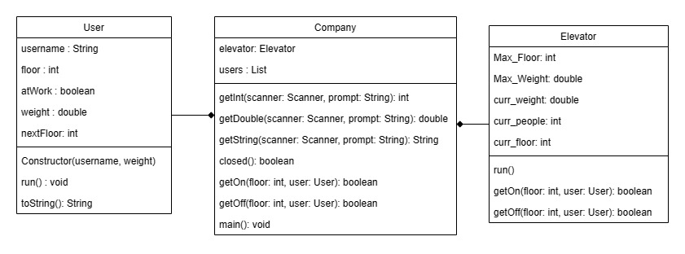
Class Diagram

Slide 17
Features used
Exception Handling
Exception handling has been used to accept user input.
User input is accepted as a string and it needs to be converted to either an integer or double
The input also needs to be validated
Since the user may provide characters when the program expects numbers, the try-catch block needs to used to check the input
This ensures the program does not crash in case invalid input is provided
Imported Packages
Some of the packages imported to support the program are:
Scanner – Used to accept user input

Slide 18
Features Used
ArrayList – used to hold a collection of user objects
Threads
The Elevator and User objects are sub-classes of the Thread class
They are run concurrently to simulate a real life situation
Receiving user input
The user provides input from the console to define the number of workers the company has
Random number generation
The amount of time a worker spends working on a certain floor is determined by a randomly generated number

Slide 19
Features Used
Search Alogirithm
In order to search for matching users in the user list, a sequential search was used since it is simple to implement and the number of workers is not expected to be large
Classes
There were 3 classes used for the program
Each of these classes had various attributes and methods

Slide 20
Conclusion
The project took quite some time to complete
It was challenging and allowed me to explore how all the features learnt can be used together to form a functional program
It was a great learning experience and the lessons learnt will definitely help me in future

